Slide 1




Your documents, on your own machine.
A free and open source desktop office suite for Windows, macOS and Linux. Write, calculate and present on your own computer, with no account and no subscription.
Abilian · Beta · October 2026
Notes:
This is Libera Suite: a free and open source office suite for writing documents, working on spreadsheets and making presentations. It runs on your own computer, on Windows, macOS or Linux. It costs nothing, and there is no account to create. The line to remember is the one in terracotta: your documents, on your own machine. Everything in the next five slides comes back to it.

Slide 2
Writing a report now comes with strings attached
TODAY
An account
A price to pay
Someone else's cloud
to create before you can type a word
a monthly fee, or your data if it's free
holding your files on their servers
Many people would rather not. What keeps them is simple: everybody sends .docx.
Notes:
Think about what it takes today to write a report on a computer. Very often: an account to create first. Then a price. Either a subscription that runs every month for as long as you keep writing, or a service that costs nothing because, as the saying goes, you are the product, and you pay with your data. And your own files, stored on servers run by somebody else. Many people and many small organisations would rather not. What keeps them is one simple thing: everybody sends Word files, and the software they use has to open them properly. That is the problem Libera Suite sets out to solve.

Slide 3

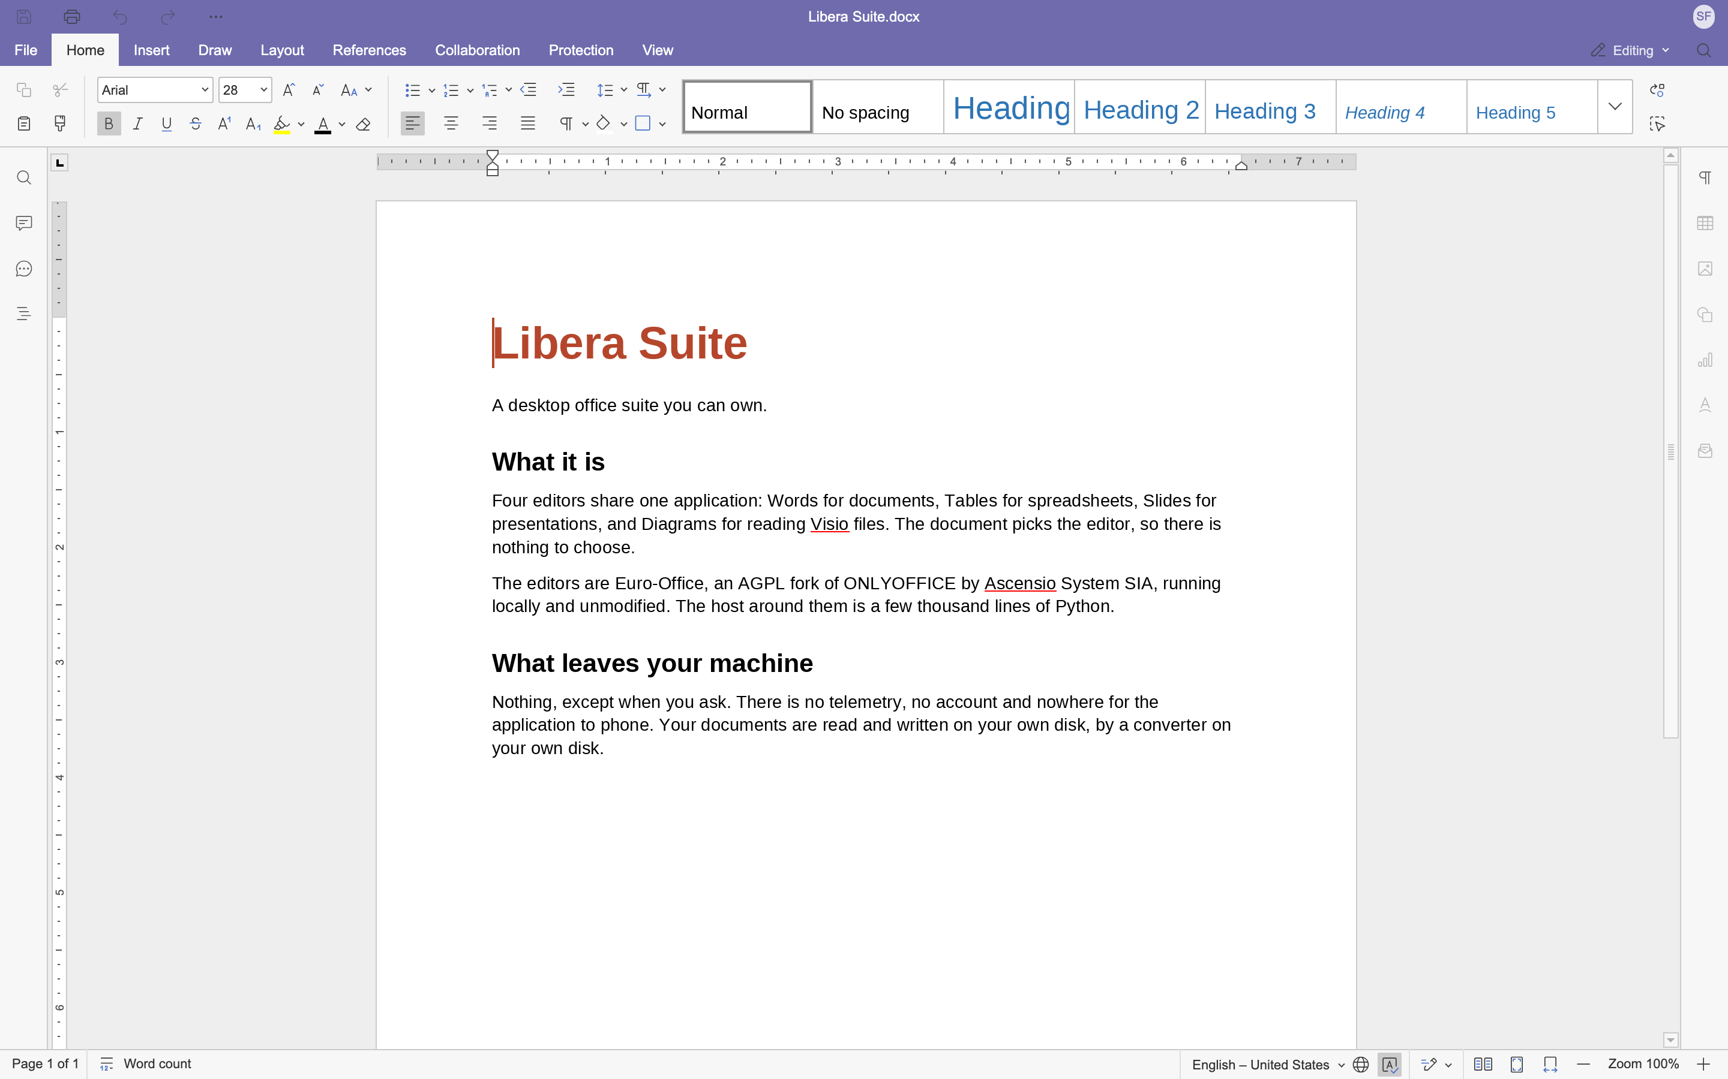


Write, calculate and present
LIBERA SUITE
Letters, reports, any document
Budgets, lists and figures
Presentations to show and share
And Libera Diagrams, to view Visio drawings.
Spell check in 5 languages
PDF export
Printing
Recent documents
Your work back after a crash
Notes:
Libera Suite is what you expect of an office suite. Libera Words for letters, reports and any other document. Libera Tables for budgets, lists and figures. Libera Slides for presentations. Libera Diagrams opens Visio drawings so you can look at them. Around them, the everyday things: spell checking in five languages, export to PDF, printing, your recent documents, and if the computer stops in the middle of your work, Libera Suite offers it back the next time you open the document.

Slide 4

It opens what people send you
WORKS WITH EVERYONE
You receive
You open it
You send back
a .docx
in Libera Words
a .docx
from a colleague, a client or a school
laid out the way its author saw it
which they open in Word as usual
Fonts, images, tables and tracked changes come through. Spreadsheets and presentations work the same way.
Microsoft Office
.docx
.xlsx
.pptx
LibreOffice
.odt
.ods
.odp
Notes:
Back to the reason people stay: everybody sends Word files. Libera Suite opens them, and lays them out the way the person who wrote them saw them, with the fonts, the images, the tables and the tracked changes. When you save, you get the same format back, so your colleague opens your reply in Word without noticing anything. The same goes for Excel and PowerPoint files, and for the LibreOffice formats. This is the slide that answers "but can I actually switch?"

Slide 5




Free, private and yours to keep
YOURS
Free
No account
No licence fee, no monthly bill. Install it on all your computers.
Nothing to sign up for. Open it and start typing.
Private
Yours to keep
No tracking. Your documents stay on your computer, never uploaded.
Free and open source software, made by Abilian in France.
Notes:
Four promises. It is free: no licence fee, no monthly bill, and you can install it on as many computers as you like. There is no account: you open it and start typing. It is private: no telemetry, no analytics, nothing about you or your documents is sent to us, and your documents are read and written on your own disk. And it is yours to keep: it is free and open source software, made by Abilian, a French company, so no server has to stay paid for it to keep working and nobody can switch it off from a distance.

Slide 6
Try the beta today
AVAILABLE NOW
Windows 10 and 11 · macOS on Apple Silicon · Linux
Download now
More info: docs.liberasuite.eu
It is a beta, and its known gaps are listed openly. The most useful thing you can send us is a document that comes out wrong.
Libera Suite's document engine and editors come from Euro-Office, a fork of ONLYOFFICE developed by Ascensio System SIA. Microsoft, Word, Excel, PowerPoint, Visio and Windows are trademarks of the Microsoft group of companies. LibreOffice is a trademark of The Document Foundation. ONLYOFFICE is a trademark of Ascensio System SIA.
Notes:
Libera Suite is available today as a beta, for Windows 10 and 11, for Macs with Apple Silicon, and for Linux. Download now takes you to the install page, and installing takes a minute. Everything else is on docs.liberasuite.eu. Because it is a beta, we publish the list of what is not finished yet, so there are no surprises. And if a document you open comes out wrong, please send it to us: that is the single most useful thing anyone can do for the project right now.

